Slide 1
The contributors who inspires me
Madhav Pandit Dasa
Santanu Mishra
Azim Premji

Slide 2
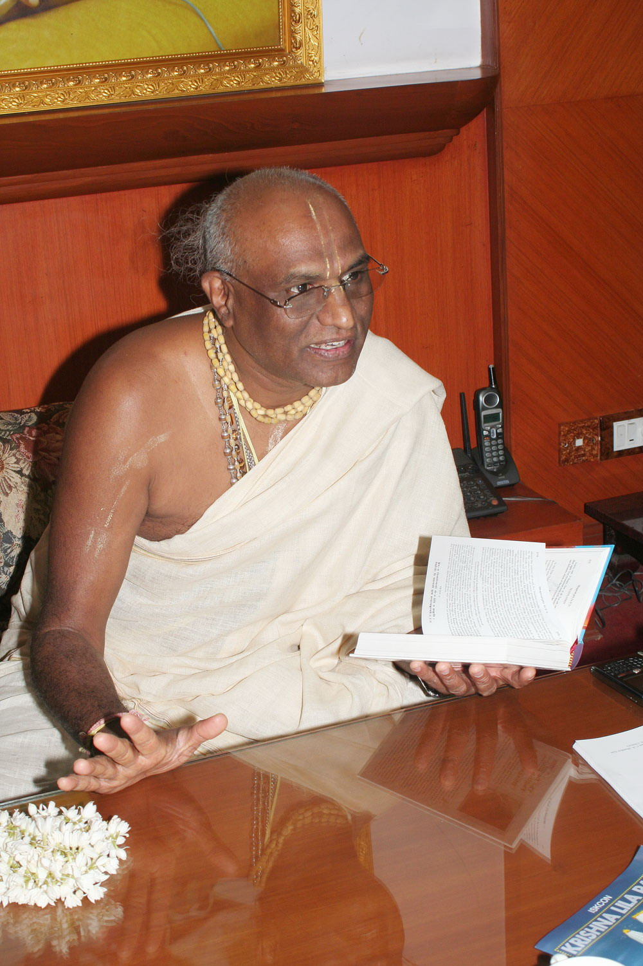
“As a student at IIT, he once came close to committing suicide. Then, he discovered Krishna and embraced the spiritual path. As head of ISKCON Bangalore, he founded Akshaya Patra-A movement which combines a missionary zeal and modern management, to feed one million hungry children every day.”
Madhu Pandit Dasa

Slide 3
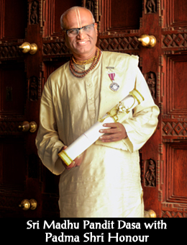
Madhu Pandit Dasa
Madhu Pandit Dasa is the President of ISKCON Bangalore and Chairman of The Akshaya Patra Foundation.
The Government of India has awareded him the prestigious Padma Shri Award in recognition of the distinguished service rendered by Akshaya Patra Foundation for the children of India.
Madhu Pandit Dasa was born in Nagercoil, India. Armed with a B. Tech in Civil Engineering from IIT-Mumbai, he dedicated himself to the service of humanity while doing his M. Tech from IIT-Mumbai in 1981.
Madhu Pandit Dasa has demonstrated his ability to build organizations of excellence in the non-profit sector, and is held in high esteem for his contribution to society in humanitarian, cultural, and spiritual spheres. Besides his achievements in the social sector, he has evolved innovative ideas in presenting the ancient cultural ethos of India in a modern, scientific and technological context.

Slide 4


HOW IT BEGAN AT THE AKSHAYA PATRA FOUNDATION
The Akshaya Patra Foundation came into being in the year 2000. A one-man initiative, The purpose of the Foundation was to serve underprivileged children by providing mid-day meals at Government schools of Bengaluru Rural District.
it started with feeding 1,500 school children and has expanded to feeding over 1.8 million children over 20 years.
Looking out of a window one day in Mayapur, a village near Calcutta, he saw a group of children fighting with street dogs over scraps of food. From this simple, yet heart breaking incident, came the determination that: No one within a ten-mile radius of any of the ISKCON temples should go hungry. Little knowing that these were just baby steps towards a bigger goal, ISKCON temples started providing food to hungry children.
As this process continued regularly, children started coming to the temple on their own, before lunch time. On speaking to some of these children one day, Sri Madhu Pandit Dasa learnt that these kids either didn’t go to school or were leaving early in order to make it to the temple for lunch. That’s when he thought of sending food to the schools themselves.

Slide 5
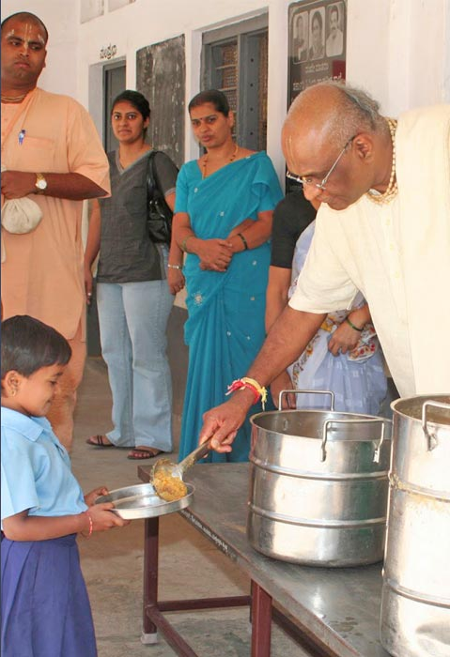
And before he really realized it, thanks to his efforts, 1,500 children in schools across Bangalore were receiving lunch from the ISKCON temple every school day. He only realized the importance of what he was doing when teachers and principals from other schools wrote in, asking ISKCON to feed children at their school too. Applications from a few lakh schools in Bangalore came in, to start the programme at their schools.
Feeding children at over a lakh schools required operations that could not be managed from within the temple premises itself. He discussed the idea with prominent personalities whom he was in touch with through the activities of the temple. People like Mr. Mohandas Pai and Mr. Narayan and Sudha Murthy, amongst others. Thanks to their collective efforts, in 2000, The Akshaya Patra Foundation was officially born.
With a large portion of the seed funding coming in from Infosys Mr. Narayan and Sudha Murthy, and Sri Madhu Pandit Dasa’s engineering background, the organisation was able to set up state-of-the art kitchens. Sri Madhu Pandit Dasa himself is the brain behind the design of the first centralized & mechanized kitchen.

Slide 6
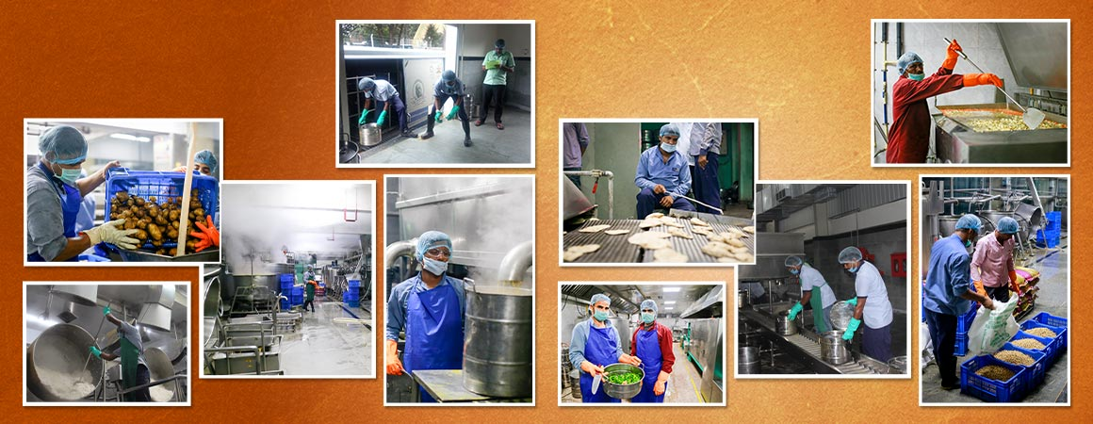
But the pandemic led to the closure of schools for an indefinite time. This resulted in children becoming visibly weaker since they did not get access to their only source of a healthy meal. To continue its service to children, Akshaya Patra began the Happiness Kits programme which ensured that their health, immunity, hygiene and learning was not hampered during the crisis. This programme began on 25th August 2020 and so far, 5 lakh beneficiaries have received the Happiness Kit that provides them with peanuts, desi chana, jaggery, ragi flour, turmeric powder, soaps, sanitisers, sanitary pack (for girl beneficiaries), activity workbook and stationeries.

Slide 7
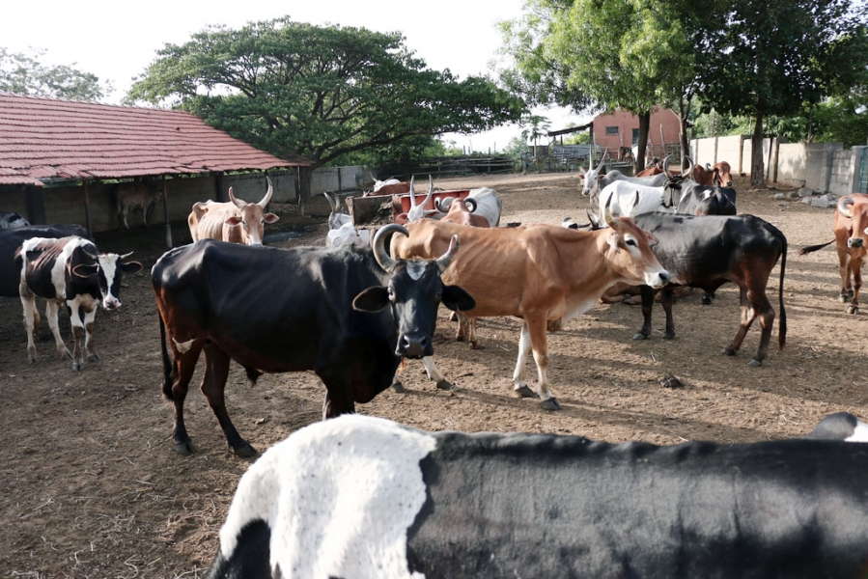
Contribution to Organic Farming
In 1994, he initiated an integrated social development project for the benefit of the rural people of Mysore and Mandya districts
The primary purpose of this is to establish self-sufficient farming communities. The farming techniques employed are traditional and organic to promote pro-environmental agriculture. Hundreds of farmers are deriving inspiration to adopt environmental and soil friendly agricultural methods researched and disseminated scientifically from this model farm. Rural women are trained in this farm in the practices and methods of organic farming. This farm is also supporting hundreds of farmers during the transition from chemical to organic farms. Many neighboring farms have successfully converted into organic farms.

Slide 8
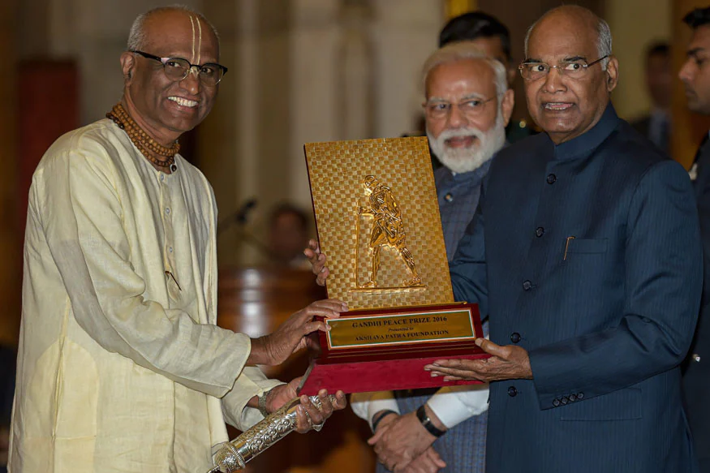
He also gave the Foundation a working Governance Model, where transparency and accountability are the core values. Based on these values, Akshaya Patra has become one of the few trustworthy NGOs in the country.
Demonstrating this point, Akshaya Patra has been awarded the Institute of Chartered Accountants of India (ICAI)’s Gold Shield Award for Excellence in Financial Reporting consecutively five times, placing the Foundation in its Hall of Fame.
Akshaya Patra won the BBC World Service Global Food Champion Award 2019, which is an annual award that honours people or causes that help societies and inspires lives.
Akshaya Patra conferred with the Gandhi Peace Prize

Slide 9
Life lesson learn from madhu pandit dasa
The best thing about “Madhu pandit dasa” which inspired me is the way he connected spiritual world to the modern day problem for betterment of the people with the help of technology.

Slide 10
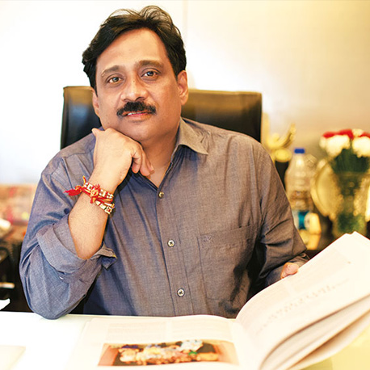
“Education is The Key to Lead a Dignified Life”
Santanu Mishra

Slide 11

Santanu Mishra
Santanu Mishra was born on July 7, 1965 in Sambalpur, Odisha, India.
Santanu Mishra is the Co-Founder and Executive Trustee of Smile Foundation and looks after the overall operations, planning and strategy of the organization.
Mr. Mishra has done his graduation in commerce stream and is a certified Company Sectary. On the academic front he further excelled by completing his management education from the Indian Institute of Management Ahmadabad (IIM-A). He has a successful stint in the corporate sector as a finance professional before devoting most of his time in the social sector.

Slide 12
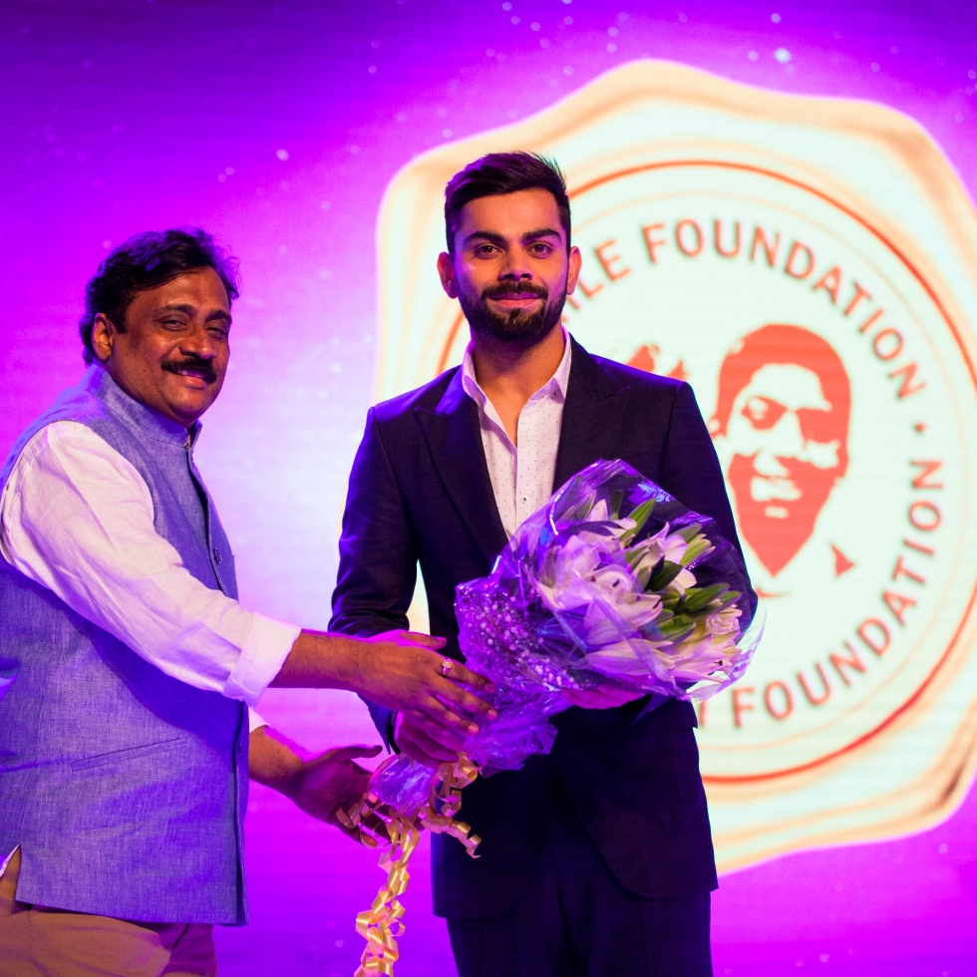
HOW SMILE FOUNDATION BORN
Santanu Mishra is the Co-Founder & Executive Trustee of Smile Foundation, a national level development organization that was established in 2002 by him and his friends as a part of their giving back to the society.
Santanu is an alumnus of Indian Institute of Management – Ahmedabad, an Associate Member of Institute of Company Secretaries of India, and a qualified lawyer.
Smile Foundation works on the subjects of education, healthcare, livelihood and women empowerment through 185 projects operational across 25 states in India.
He comes from a background where volunteerism comes naturally from school days. So doing social good in one or other way always remain in the back of the mind. At present, Smile Foundation has 74 Mission Education projects functional across India.
Santanu is the producer of Feature Film “I am Kalam”, which has achieved astounding success with the film travelling to over 30 countries and winning 22 national and international awards. With “I am Kalam” Smile Foundation advocated the cause of Sending Every Child to School.

Slide 13
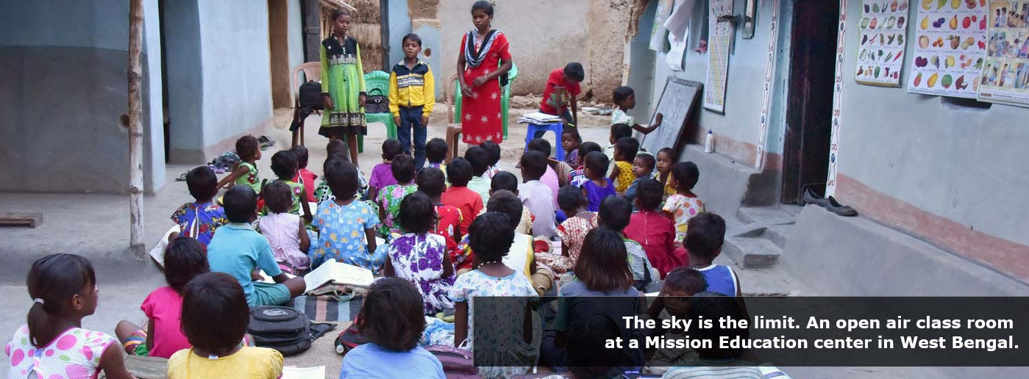
Various social projects initiated by Santanu Mishra&team
Since 2002 Smile Foundation has been working on the subjects of education for children, livelihood for the youth, healthcare in rural villages and urban slums, women empowerment and sensitization of the privileged masses through following programmes.
Mission Education- The Education Programme for Underprivileged Children
Through the Mission Education(M.E) programme, Smile Foundation provides basic education and healthcare to underprivileged children, finally mainstreaming them to formal education. ME programme brings underprivileged children to the fold of education who otherwise would have missed the chance of empowerment for another generation. The education focuses on the overall personality development of a child.
At present, Smile Foundation has 74 Mission Education projects functional across 21 states of India. Mission Education has so far main streamed a little more than 39,000 children from its centres into 84 renowned schools across India.

Slide 14
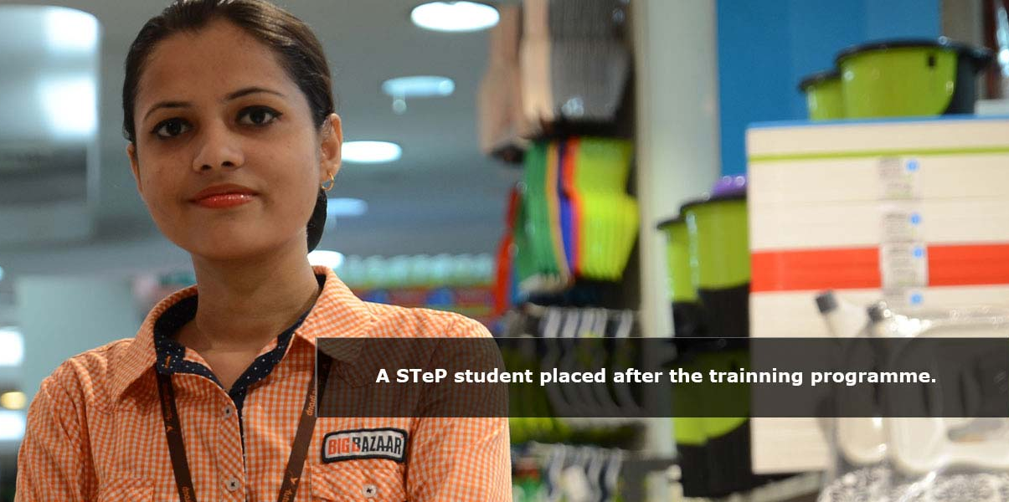
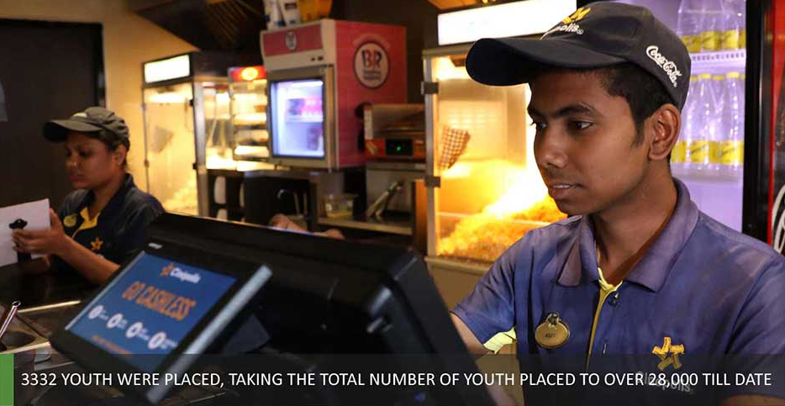
Smile Twin e-Learning Programme (STeP) – The Livelihood Programme for Underprivileged Youth
Smile Twin e-Learning Programme (STeP) is a national programme that trains urban underprivileged youths in market-centric job skills and make them employment ready. Through this programme, training in key employability skills like English proficiency, computer operations, personality development etc is given to students. This helps them in getting a job in the growing retail and service sector.
13,500 trained and as many as 9500 STeP students have now been employed in more than 140 companies like Café Coffee Day, Domino’s Pizza, Westside Stores, ICICI, HDFC, Reliance Retail, Big Bazaar, Spencer, Croma etc.
At present, 54 STeP center’s are operational across 38 cities in 19 Indian states of India.

Slide 15
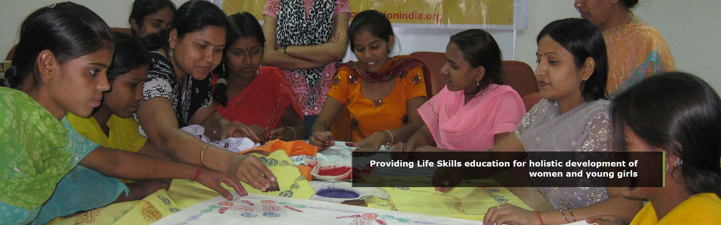
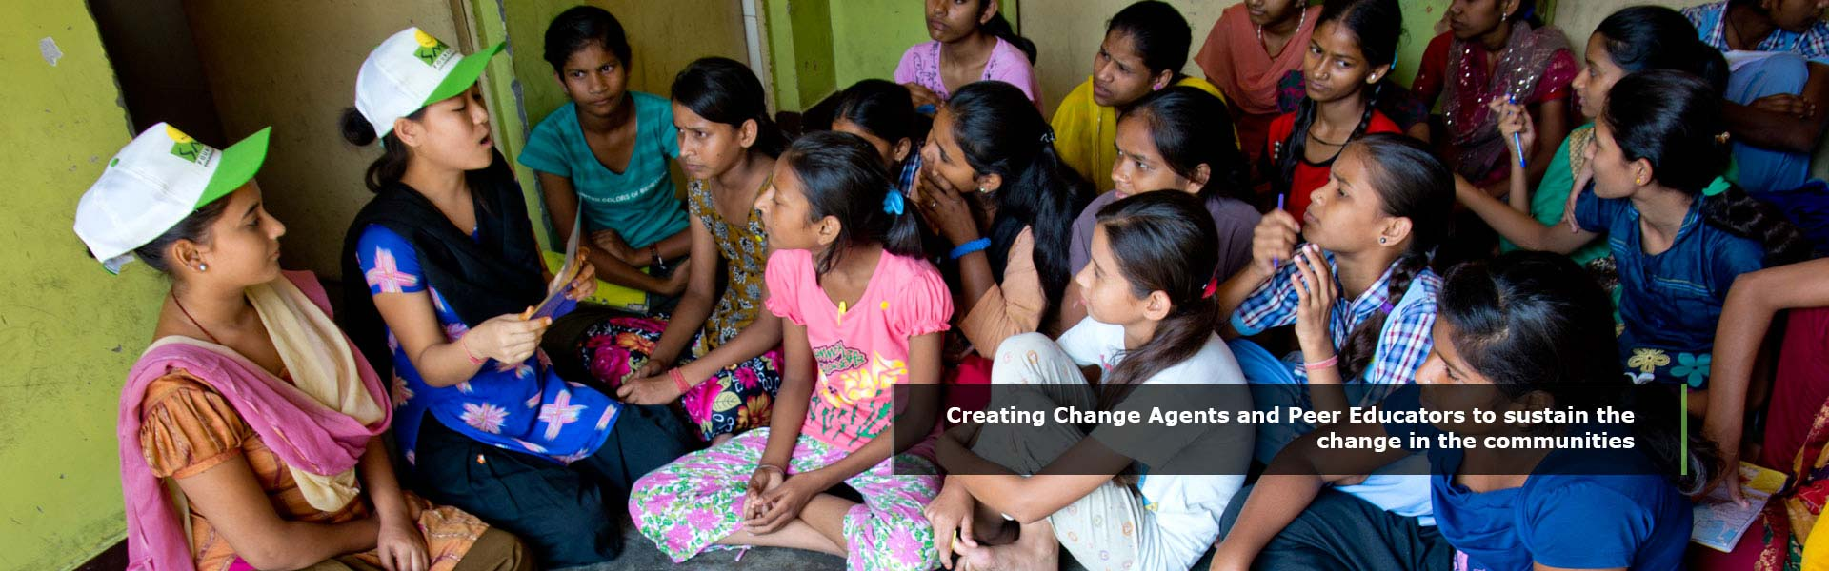
SWABHIMAN- A Programme on Girl Child & Women Empowerment
Initiated in the year 2005, the programme is specifically aimed at realization of both individual and collective self-esteem and inner strength for marginalized and socially excluded women and adolescent girls through innovative community practices.
The programme identifies adolescent girls and women from the community and developing them into Change Agents, who in turn actively contribute to the community mobilization process. Select Change Agents are then developed into Master Trainers who can advocate and sensitize women and girls regularly. ‘Swabhiman’ works towards its objective of all round development of women and girls, through the following interventions:
Providing Reproductive Health and Child Health Services Male Involvement & Attitudinal and Behavioural Changes Imparting Life Skill Education Networking and Convergence Support Sensitization of privileged Women and Youth
The programme has benefited over 150,000 women and girls since inception.

Slide 16
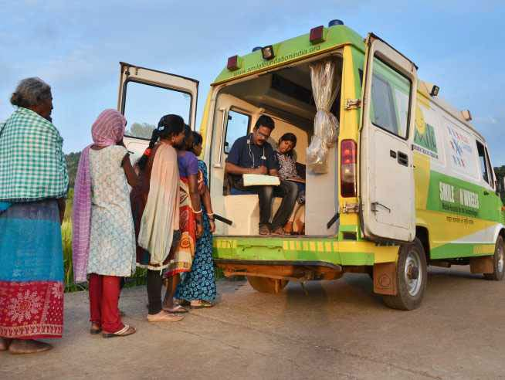
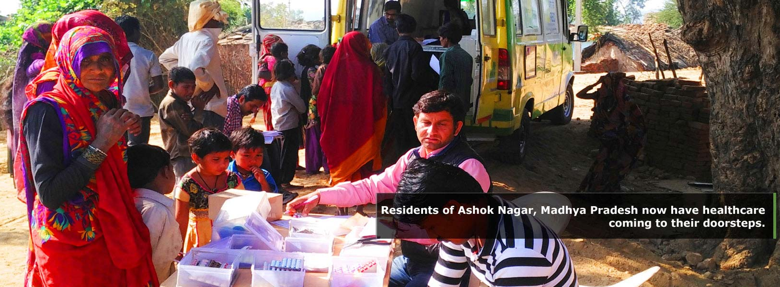
Smile on Wheels (SoW) – Innovative Mobile Hospital Programme
Smile on Wheels is a national level multi-centric project initiated by Smile Foundation with an objective of providing a comprehensive range of healthcare services to under-privileged community in outreach, remote rural areas and urban slums through equipped mobile hospitals. The programme is based on innovative concept of “Community centric sustainable health delivery model.” The programme focuses on providing wide range of promotive, preventive and curative health services to the beneficiaries. The model envisages an efficient and cost effective health delivery system for the community.
Smile’s vision through SoW is to provide affordable & advance health care facilities at the door steps of the underprivileged communities. Till now Smile On Wheels has benefited over 5, 00,000 people.

Slide 17

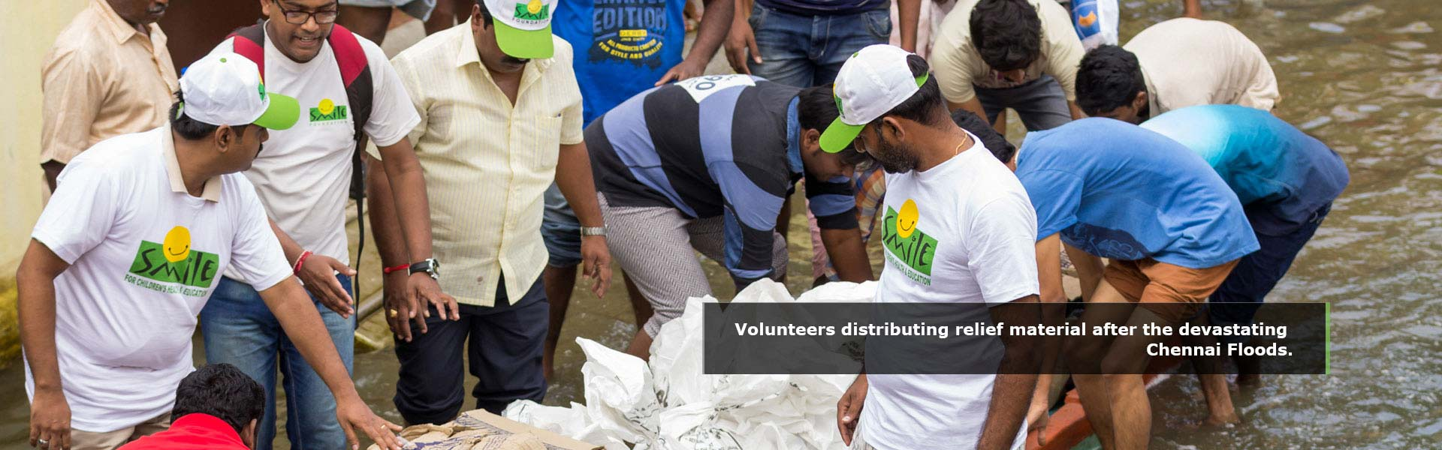
Disaster Response
Smile Foundation, with its welfare interventions focused on children and their families, responds to the call of humanity in times of such calamities under its Disaster Response programme through emergency relief programs. From the Kashmir earthquake in 2005 to the Uttarakhand floods, Smile Foundation has acted promptly to reach out and respond to the immediate needs of the disaster affected people, while also maintaining a sustainable approach to help them rebuild their lives by facilitating their education, healthcare and livelihood.
Some of the calamities during which Smile Foundation has initiated crisis management during disaster are the Tsunami, the Kashmir Earthquake, the Maharashtra floods, the Bihar floods and the Uttarakhand floods.

Slide 18
Life lesson learn from Santanu Mishra
Being from small village, doesn't mean you can not help others,
After studied from IIM he could have work with MNC in foreign but he chose to be in india and work for development of society.

Slide 19

“I strongly believe that those of us, who are privileged to have wealth, should contribute significantly to try and create a better world for the millions who are far less privileged” — Azim Premji
Azim Premji

Slide 20
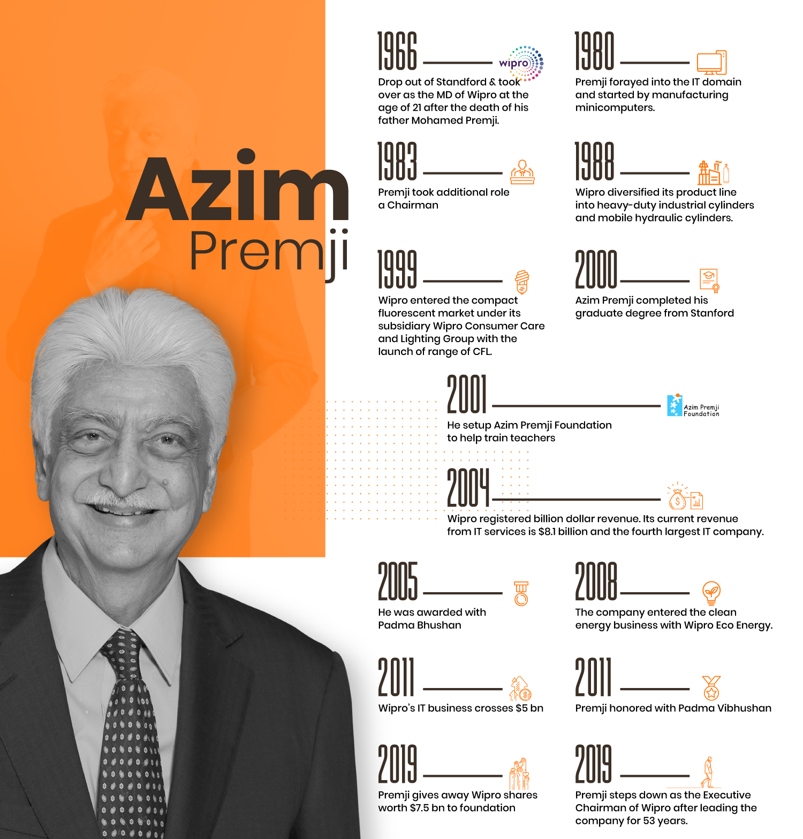
Azim Hashim Premji (born 24 July 1945) is an Indian business tycoon, investor, engineer, and philanthropist, who was the chairman of Wipro Limited. Premji remains a non-executive member of the board and founder chairman. He is informally known as the Czar of the Indian IT Industry.
Premji was born in Bombay, India in a Gujarati Muslim family. Premji has a Bachelor of Science in Electrical Engineering degree from Stanford University
Azim Premji is arguably the most generous of all the Indian philanthropists. He is not an individual who gives charity just for the sake of complying with the CSR initiatives, but the kind-hearted business tycoon is a born philanthropist. The pace at which he makes money is in complete sync with the pace at which he gives the charity. The Azim Premji Foundation has field institutes in 40+ districts across 6 states and one union territory.

Slide 21
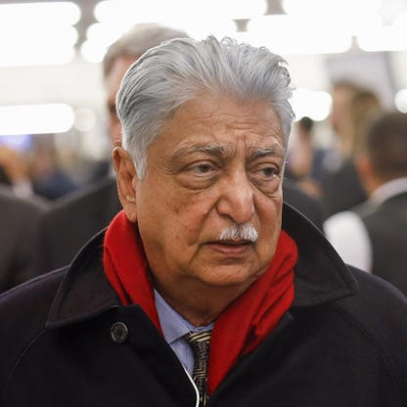
Making of Azim Premji: The Philanthropist
The journey of the kind-hearted entrepreneur started back in 2001 with the endowment of Wipro shares worth $125 million to the Azim Premji Foundation. However, with years of planning, things started to change as Premji expanded the foundation with each passing year.
Azim Premji is not just known as a top philanthropist in India, but he’s one of the well-recognized philanthropists the world has seen in this age. Between 2001 to 2019, Premji donated Wipro shares worth $12 billion to the endowment. He recently made the single-largest donation, transferring economic ownership of 34 percent of his shares in Wipro to Azim Premji Philanthropic Initiatives and Azim Premji Trust.
The desire to give back to society has always pushed Premji to go an extra mile than other entrepreneurs to uplift the unprivileged communities. He was inspired by the spirit of his mother to impact the lives, who was a trained doctor and spent a lifetime contributing towards setting up a children’s orthopedic hospital in Bombay. Premji deliberated on putting great effort into one of the key problems in society, such as education, nutrition, healthcare, and good governance. He chose primary education as the most important segment to direct his attention and the foundation started working towards the same.

Slide 22
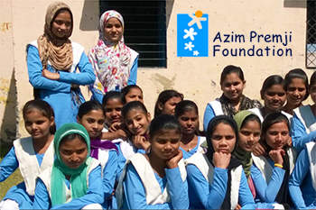
Azim Premji Foundation
The Azim Premji foundation set up by the ever-generous magnate trains thousands of teachers in as many as 50 districts across six Indian states. It intends to enhance the education system in government schools by equipping the teachers with a basic understanding of modern education.
In December 2010, he pledged to donate US$2 billion for improving school education in India. This has been done by transferring 213 million equity shares of Wipro Ltd, held by a few entities controlled by him, to the Azim Premji Trust. This donation is the largest of its kind in India. In March 2019, Premji pledged an additional 34% of Wipro stock held by him to the foundation. At a current value of about US$7.5 billion, this allocation will bring the total endowment from him to the foundation to US$21 billion.
In May 2020, the Azim Premji Foundation collaborated with the National Centre for Biological Sciences, and the Institute for Stem Cell Science and Regenerative Medicine for augmenting testing infrastructure to deal with the coronavirus pandemic.

Slide 23
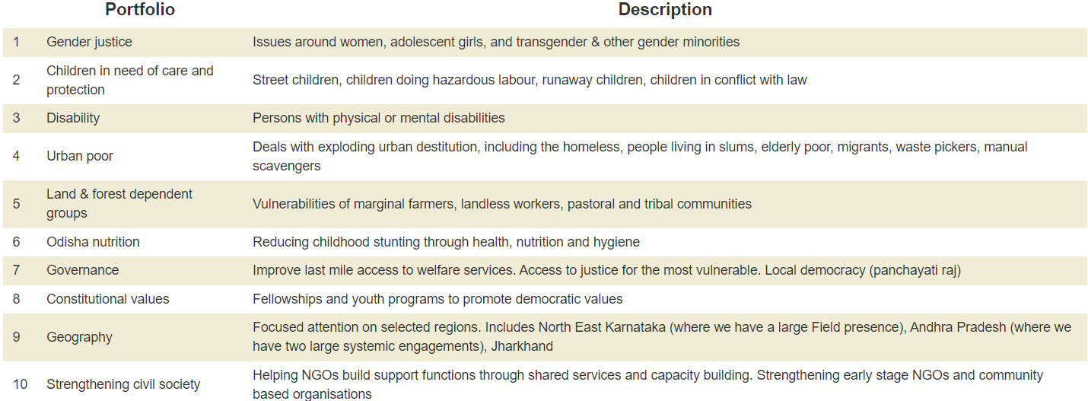
Areas of work

Slide 24
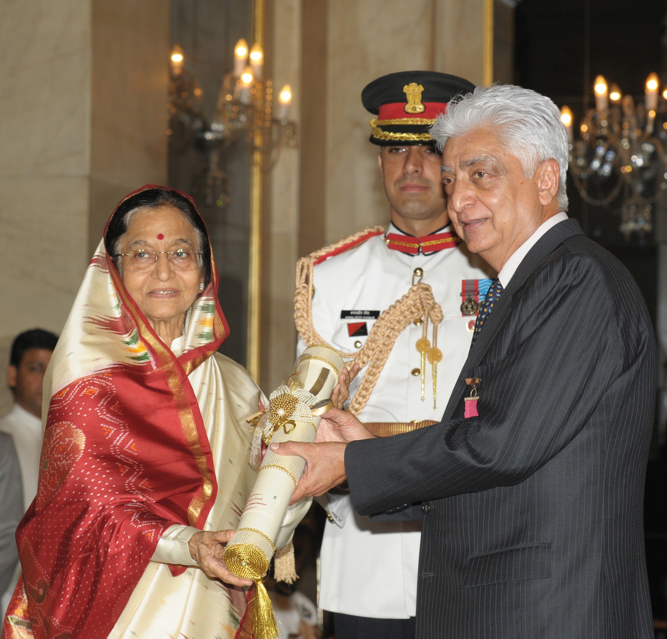
The primary source of the foundation is the returns from Azim Premji’s family office, which makes the business of philanthropy robust even without the fortunes of Wipro. Azim Premji may have crafted a very successful IT company, but the legacy he has created in the world of philanthropy is surely unmatched.
For his immense philanthropic work he received an honorary degree in 2009 from Wesleyan University in Middletown, Connecticut for his outstanding philanthropic work.
- He received the India's second highest honour Padma Vibhushan in 2011 by the Government of India.
In 2000, he was ranked among the twenty most powerful men of the world by AsiaWeek and by Time Magazine one of the hundred influential people in the world.

Slide 25
Life lesson learn from azim primji
One way of achieving excellence, is by looking at those better than ourselves. Keep learning what they do differently. But excellence cannot be imposed from the outside. We must also feel the need from within. It must involve not only our mind, but also our heart and soul.

